Slide 1
Nature and Mental Health
Rick Pongratz, Ph.D.
Counseling and Mental Health Center (CMHC)
Division of Student Affairs

Slide 2
Holding our space
Land recognition
Indigenous peoples
Setting intention

Slide 3
Overview
What do we mean by “nature”?
Shifts in our relationship with nature
Research on nature and mental health
Rethinking our connection with nature

Slide 4
Looking inward
Early experiences?
When did it change?
For the better
For the worse
Current relationship with nature

Slide 5
Changes in Relationship to Nature
Over 50% of people now live in urban settings. In the US…
200 years ago, 7% lived in cities
In 1970, 75% lived in cities
In 2024, it was 86%
Agricultural to industrial shifts
iPhone introduction 2007
Time spent on screens?
Distraction-based coping

Slide 6
Climate Change and Climate Anxiety
Weather
Water
Land
Air
Study on adolescent and young adult reactions to climate change (Hickman et al, 2021)
Ages 16 - 25
59% felt “very” or “extremely” worried
>45% reported that their feelings negatively impacted their daily life
50% felt anxious, sad, helpless, and angry

Slide 7
Treatment re: Climate Distress
Mental health models must adapt: Internal, interpersonal, socio-political/cultural…ecosystemic
Climate Distress vs. Avoidance (in client and provider)
Acute (e.g. wildfire) vs. Holistic (e.g. fears for the world of our children)
Treatment -
Calm the fight/flight system…meditation, mindfulness, etc.
Engagement in value-directed work related to climate and nature - plant trees, make bee habitats, etc.
Grief acknowledgement - guilt, anger, etc.
Work that reconnects

Slide 8
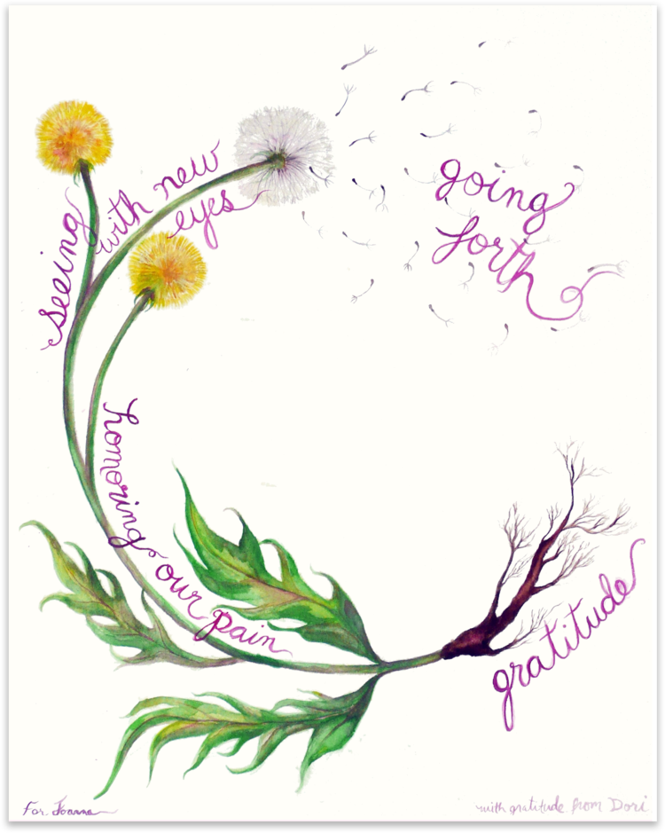

Slide 9
Nature Prescriptions
PBS News Hour – Why doctors are increasingly prescribing nature

Slide 10
Experiential Engagement
Open up to nature

Slide 11
Research Findings
Improved attention
Lower stress
Better mood
Reduced risk of psychiatric disorders
Upticks in empathy and cooperation
Surgery recovery
Prisons
Playgrounds
Positive social interactions
Even videos improved attention and emotion
Reductions in cortisol levels
Biodiversity matters
Nature and antidepressants

Slide 12
Some Specifics
Gazing at greenery for 40 seconds, as opposed to a concrete ceiling reduced mistakes in experimental conditions (Lee, K.E., et al., 2015).
Listening to nature sounds improved performance on cognitive tasks compared to traffic or café sounds (Van Hedger, S.C., et al., 2019).
Contact with nature improves happiness, well-being, positive affect, positive social interactions, sense of purpose, and decreases mental distress (Bratman, G., 2019).
Exposure to green space from birth to age 10 linked with reduced risk of many mental health disorders later in life (Engemann, K., et al., 2019).

Slide 13
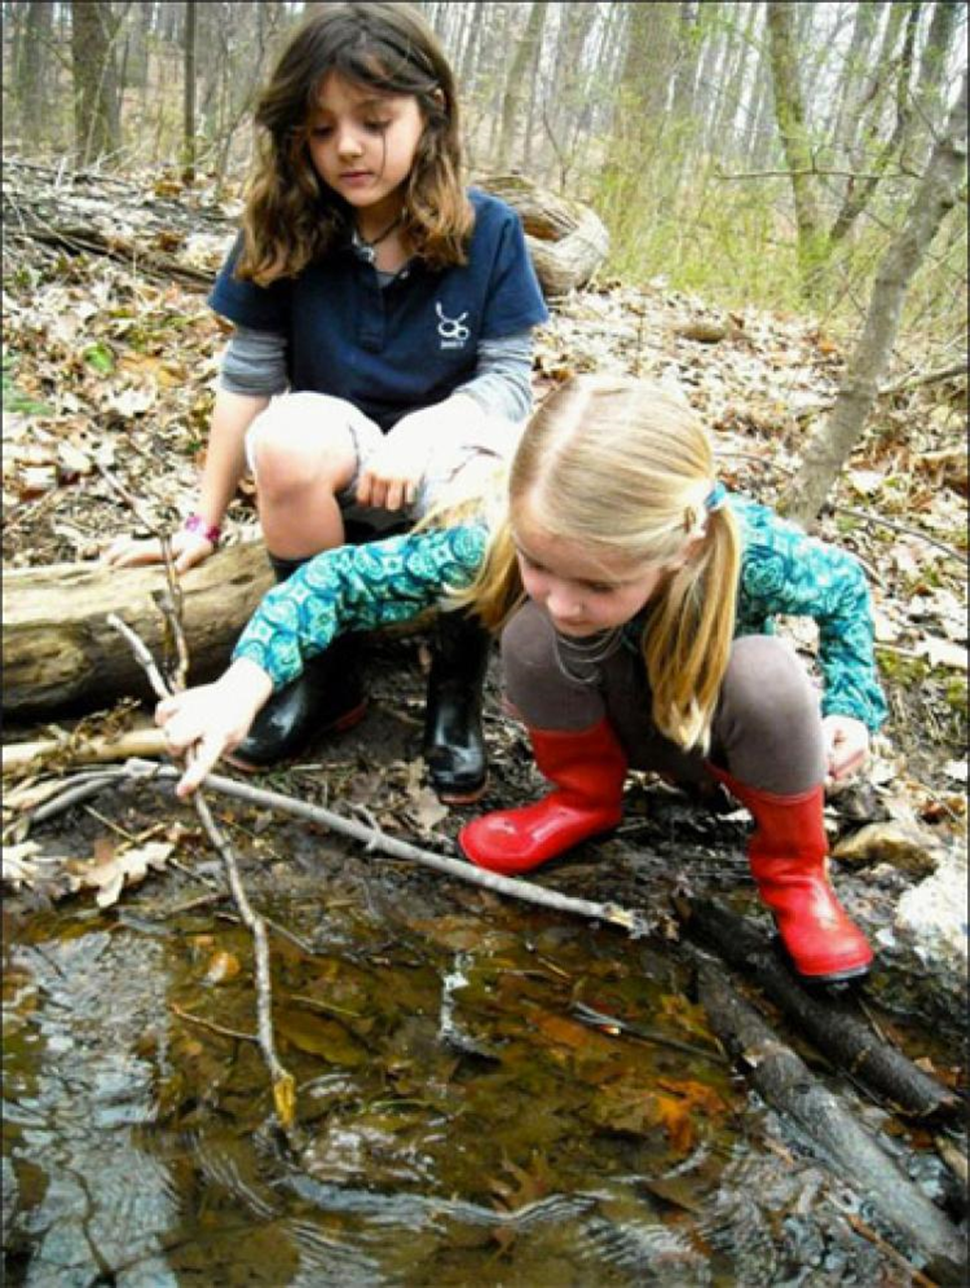
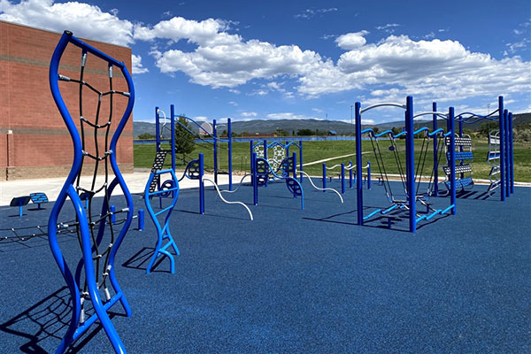
Playgrounds

Slide 14
The Role of Awe
What is Awe?
When have you felt this?
How else did you feel?

Slide 15
The Role of Awe
Reverential wonder toward something bigger than ourselves, or, that we are a part of a much bigger whole.
Study 1 with military vets – Being awed linked with increased well-being more than any other positive emotion.
Study 2 – Diary of everyday life experiences with nature
Allowing ourselves to be open to being awed by nature changes our lives. Seek to be awed.

Slide 16
Experiential Enagement #2
Finding Awe

Slide 17
Experience vs. Connection
Time in nature – aim for 2 hrs/wk
A felt sense of connection (which requires intention) is more helpful than just “being” out of doors.
Connection with nature buffers against social isolation/loneliness

Slide 18
Theories on How and Why?
Sounds – frequency and cues
Artificial – inward focus
Nature – outward and lowers fight/flight/freeze/fawn response
Smells
Research on oils
Sights
Touch
Mindfulness
Screens
Evolution (aka innate drive)
Sensory
Exercise

Slide 19
Birdsong
Seeing or hearing birds in everyday life resulted in self-assessed improvements in mental wellbeing for both depressed and not depressed subjects (Hammoud, et al.; 2022).
Recorded soundscapes comparing birdsong and traffic noise as well as the diversity of birdsong/traffic (Stobbe, et al.; 2022)
Traffic sounds increased depression (more diverse traffic was worse).
Birdsong decreased depression, anxiety, and state paranoia (more diverse songs were better).

Slide 20
Nature as Therapy
Forest Bathing
Wilderness and Adventure Therapy
Animal Therapy
Conservation, Farming, Horticulture as Therapy
Green exercise
Mindfulness-based Ecotherapy
Nature-based Counseling

Slide 21
Forest Bathing – Dr. Qing Li
Lowers stress hormones cortisol and adrenaline
Suppresses the sympathetic (fight/flight/freeze/fawn response) system
Enhances parasympathetic (rest/recover) system
Lowers blood pressure and increase HRV

Slide 22
How to Forest Bathe
Leave tech and distractions behind
Set aside expectations
Slow down, ignore time
Present focus
Find a spot to sit
Notice – all your senses
Target two hours…minimum 20 minutes

Slide 23
Levels of Nature-Based Therapy
Using nature for improving my mental health.
“How can this help me?”
Reciprocal relationship with nature
Connection
Member of the family
Greetings

Slide 24
Incorporating Nature
Mindful connections throughout our day
Commuting
Windows
Transition times
Being outside
Small & meaningful doses
Big (& meaningful) doses
Bringing the outside in
Visualization/pictures/videos/audio

Slide 25
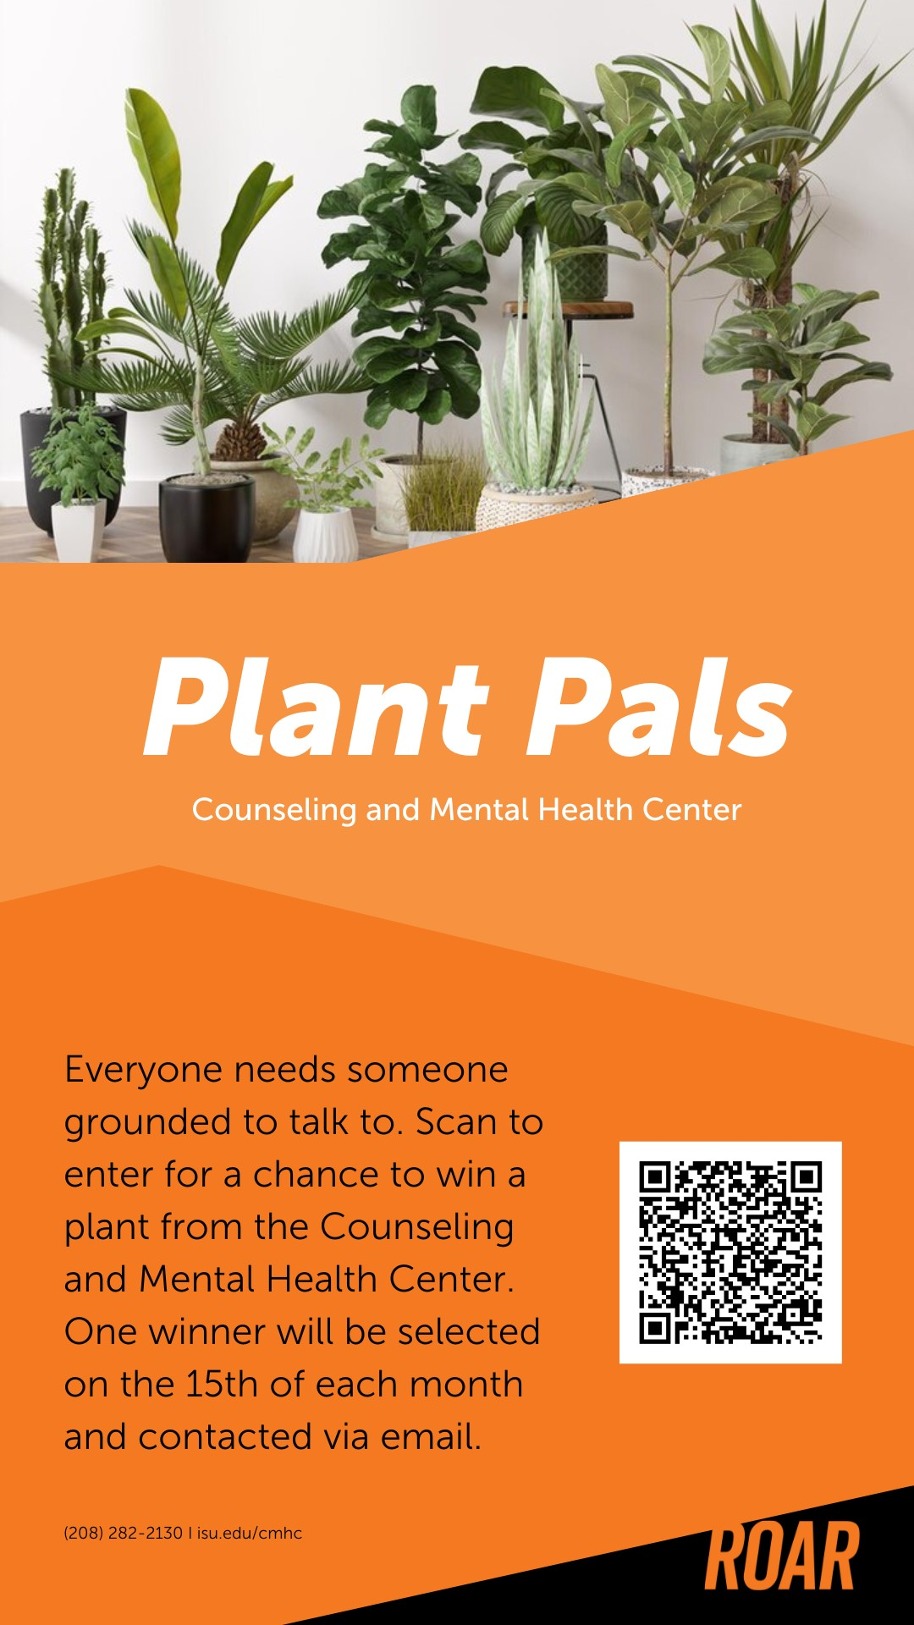

Slide 26
Activism Opportunities
Shoshone-Bannock Tribes
Conservation Orgs
Individual Opportunities
Professional engagement
APA Division 34
ACA Climate Change Fact Sheet
National Association of Social Workers

Slide 27
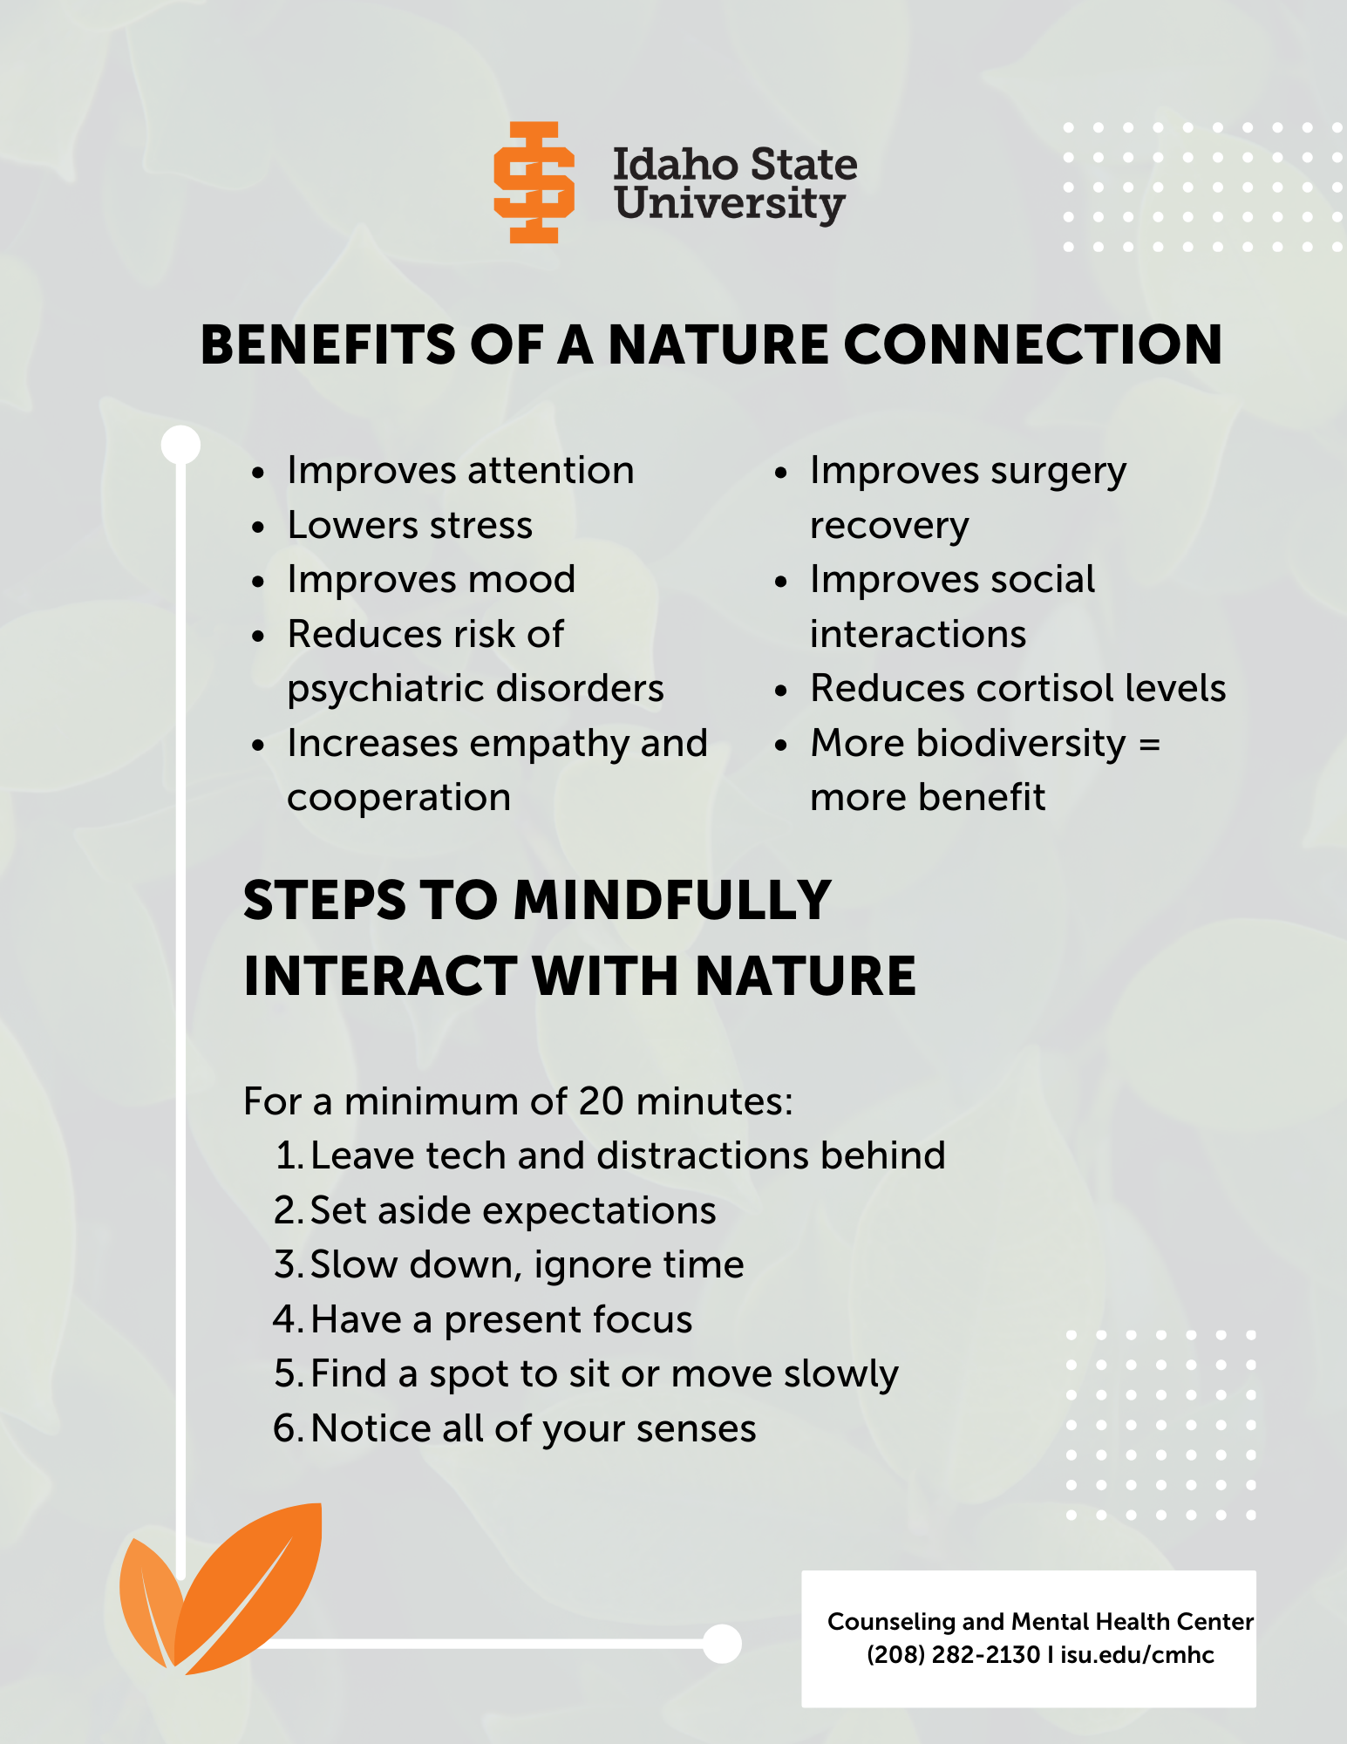

Slide 28
Summary
Changes:
Don’t worry about making big changes.
Make small changes that can become a habit
Personal – Home/work
ISU – Inside and Out

Slide 29
(if time allows) Experiential #3
Open up to a connection with nature ally

