Slide 1
BA in Sociology Orientation
Department of Sociology, Social Work, and Criminology
Idaho State University

Slide 2
Our Program - What do we offer?
BA in Sociology
BA in Sociology with a concentration in Criminology
Minor in Sociology
Average numbers of majors in Sociology in recent years: 80-90
Average number of minors in Sociology in recent years: 20-30

Slide 3
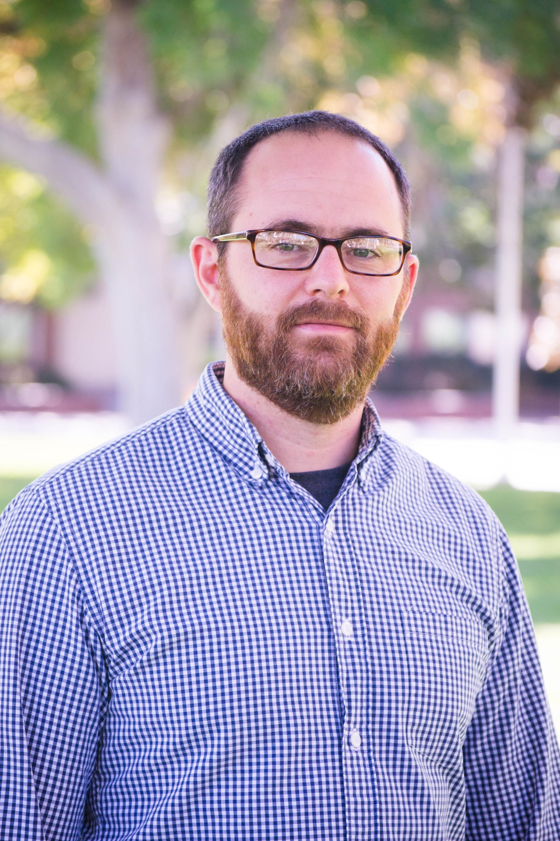
Our People
6 faculty members in sociology teach and advise the students in the BA program.
Some Social Work faculty members also teach some sociology courses.

Slide 4
Our People
Morey Burnham, Ph.D., Assistant Professor – Environmental Sociology
Deirdre Caputo-Levine, Ph.D., Assistant Professor, Criminology
Scott Contor, M.A., Lecturer, Sociology
Gesine Hearn, Associate Professor, Ph.D., BA Program Director, Health and Illness
Tony Hoskin, Ph.D., Professor, Criminology Program Director, Criminology
Sarah Liftawi, M.A., Lecturer, Criminology
Katrina Running, Ph.D., Associate Professor, MA Program Director, Environmental Sociology
Jeremy Thomas, Ph.D., Associate Professor, Department Chair, Director, Minor in Gender and Sexuality Studies; Religion and Sexuality

Slide 5
What Is Sociology? – A refresher
SOCIOLOGY is the study of social life, social change, and the social causes and consequences of human behavior. Sociologists investigate the structure of groups, organizations, and societies and how people interact within these contexts.
American Sociological Association 2014

Slide 6
Why study Sociology?
Sociology graduates work in a variety of occupational fields, including social services, counseling, marketing, sales, teaching, librarians, social science research, and management.
The Bureau of Labor Statistics projects a 5% increase in employment for sociologists from 2021 to 2031, as fast as the average rate for all occupations.
Jobs for sociology majors are also projected to increase in Idaho.

Slide 7
What can I do with a BA in Sociology?
Government services- federal, state, local; program administration and evaluation, research, policy analysis
Social services- rehabilitation, case management
Health services -family planning, substance abuse, counseling, hospital admissions, insurance companies
Community work- nonprofit organizations, community development, environmental groups
Corrections- probation, parole, correctional facilities

Slide 8
What can I do with a BA in Sociology? (cont)
Business- advertising, marketing, consumer research, insurance companies, real estate, human resources
Colleges and universities -admissions, alumni relations, placement offices, institutional research
Publishing - journalism, public relations writing, research, editing
Teaching- elementary and secondary schools (with appropriate teacher certification)
Preparation for professions such as law, social work, counseling, public health, criminology, or public administration

Slide 9
What will you learn?
An understanding of the relation between individuals and social institutions
Sociological explanations of social issues
Basic skills in research design
Data analysis using statistical software
Ability to interpret research findings
Ability to develop evidence-based arguments
Writing Reports
Analytical and critical thinking skills
Knowledge in content areas such as criminal justice, environmental sociology, social inequality, or health and illness.

Slide 10
Required Course Credits
18 credits required courses
+ 18 credits elective courses
____________________________
= 36 credits in sociology courses

Slide 11
Required Courses
Required Sociology Courses | 18
Soc 1101 Introduction to Sociology (also counted for Objective 6) | 3
Soc 3301 Classical Social Theory | 3
Soc/Sowk 3308 Sociological Methods and Social Work Research or PSYC 3303 Psychological Research Methods | 3
Soc 3309 Social Statistics | 3
Soc 4403 Contemporary Social Theory | 3
Soc 4462 Power Class and Prestige | 3
All courses must be completed with a C- or higher!
Sociology Electives 15 Credits Must be Upper Division Pick from any sociology electives listed in the catalog, excluding SOC 4482. | 18

Slide 12
Our Electives – 2000 and 3000 level
SOC 1102 Social Problems
SOC 2201 Introduction to Gender and Sexuality Studies
SOC 2248 Critical Analysis of Social Diversity
SOC 3321 Families in Social Context
SOC 3330 Sociology of Health and Illness
SOC 3368 Sociology of Religion

Slide 13
Our Electives - 4000 level
SOC 4408 Advanced Sociological Methods
SOC 4412 Sexuality and the Body
SOC 4413 Mind Body and Society
SOC 4421 Families in Social Context
SOC 4435 Environmental Sociology
SOC 4466 Rural Sociology and Community Development
SOC 4491 Topics in Sociology

Slide 14
Electives – Criminology Courses
SOC 2231 Juvenile Delinquency
SOC 3310 Introduction to Criminal Justice
SOC 4431 Criminology
SOC 4436 Elite Deviance and Crime
SOC 4438 Sexual Crimes
SOC 4451 Victimology
SOC 4452 Gang Violence
SOC 4453 Serial Murder
SOC 4454 Guns and Mass Shootings
SOC 4455 Prisons, Reentry, Reintegration
SOC 4456 Substance Abuse: Family and Community
SOC 4457 Fundamentals of Forensic Behavioral Science
SOC 4492 Topics in Criminal Justice

Slide 15
Course Sequences - Freshman and Sophomore Year
Semester 1 and 2: General Education Courses
– take SOC 1101 (Obj. 6) to also count towards sociology major
Some electives (any)
Semester 3 Fall: General Education Courses
– take SOC 2248 (Obj. 7) or SOC 2201 (Obj. 9) to count towards Soc major
SOC 3308 Sociological Methods
SOC 3301 Classical Social Theory
Semester 4 Spring: General Education Courses
SOC 3309 Social Statistics
SOC 4403 Contemporary Social Theory
SOC electives - 3000 level and up

Slide 16
Course Sequences - Junior and Senior Year
Semester 5 Fall: SOC elective courses – 3000 level and up
Free Elective Courses
Semester 6 Spring: SOC 4462 Power, Class, and Prestige
Elective Courses – sociology and free
Semester 7 and 8: finish with elective courses to reach:
120 total credits required for BA degree including:
36 credits in upper division courses
36 credits in general education courses
36 credits in Sociology

Slide 17
Sequences of Courses – Tips
Take SOC 1101 first, then take a lower level elective early
SOC 3308 and SOC 3301 are only offered in FALL
SOC 4403 and SOC 4462 are only offered in SPRING
Take SOC 3308, then SOC 3309
Take SOC 3301, then SOC 4403
Some electives (upper and lower level) are offered in SUMMER
SOC 3308 is often also offered in SUMMER
Don’t jump to 4000 level courses too early

Slide 18
“Weird” Courses – not just for anybody
SOC 4482 Sociology Internship
1-3 Credits, may be repeated for up to 6 credit; 2.5 hours of work for each credit
Offered on Demand
Prerequisites: Permission of Instructor; Junior status; minimum of 12 hours and 3.0 GPA in sociology.
SOC 4483 Independent Problems
1-4 Credits, may be repeated for up to 6 credits
Offered on demand
Prerequisites: Sociology major; Permission of Instructor; G.P.A. of 3.0 or higher and at least 12 hours of sociology credits, advanced Junior Status.
SOC 4482 and SOC 4483 do not count towards required/elective courses for Sociology, but the credits count towards the 36 upper-division credits required by ISU for graduation.

Slide 19
How to make the most of your studies
Talk to us – FREQUENTLY!
Plan AHEAD – courses are not offered every semester!!
Take 1000 and 2000 level courses FIRST, THEN advance to 3000 and THEN to 4000 level courses.
Expect HIGHER expectations, MORE work, and MORE complex assignments at the 3000 and 4000 level of courses.
Read your syllabi – CAREFULLY!
READ, READ, READ
WRITE, WRITE, WRITE - Writing takes practice. Do it OFTEN and REPEAT!

Slide 20
How to make the most out of your degree – tips for employment
Sell the SKILLS!
Show people who you are, what you have done and what you have learned.

Slide 21
How to make the most out of your degree – tips for employment
Assess Your Skills
Translate what you have learned in Sociology into the kinds of skills employers are looking for?
Examples:
× Bringing a clear understanding of race/ethnicity/gender/sexuality and being comfortable with the language to discuss identities is a REAL SKILL
× Knowing how to create a survey and administer it to a representative sample of a population is a REAL SKILL
× Being able to conduct one-on-one interviews to gain information about a topic is a REAL SKILL

Slide 22
What skills do you have? Tips for employment
Communication: did you present ideas orally; write research papers; summarize literature; and listen carefully?
Quantitative Reasoning: can you use data to create tables? Can you interpret tables and draw conclusions? Can you analyze data using a statistical program?
Qualitative Inquiry: did you conduct interviews? Have you done any observations? Can you create a typology from those observations?
Project Management: did you do a research project or work on a team project? What was your role? What was your strength?
Research Design: did you design research projects? What were your strengths? What parts of the research process did you most enjoy?
Ethics/Engagement: did you have conversations about ethics? Do you want to work on projects that brings in underrepresented groups?

Slide 23
What kind of job should I apply to?
THINK!
Who are you?
What do you want to do?
What are good at?
What you want your life to look like?

Slide 24
Questions?

