Slide 1
Dizziness and Fall Risk
Deanna Dye, PT, PhD
Jeff Brockett, EdD, CCC-A
Examination Techniques and Interpretation

Slide 2
Elderly Issues
Fall Risk – A Growing Problem

Slide 3
Presentation Outline
The nature of the problem
The anatomy of balance
What can go wrong
The very basics of assessment
Practice
Questions

Slide 4
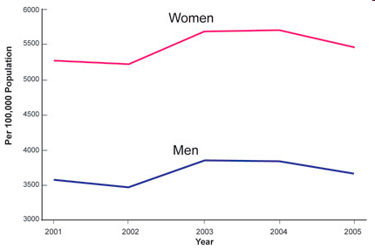
Age Adjusted Nonfatal Fall Injury Rates* Among Men and Women Aged 65 Years and Older, United States, 2001–2005
Reference: Centers for Disease Control and Prevention, National Center for Injury Prevention and Control. Web-based Injury Statistics Query and Reporting System (WISQARS) [online]. (2005) [cited 2006 Aug 20]. Available from URL: www.cdc.gov/ncipc/wisqars.

Slide 5
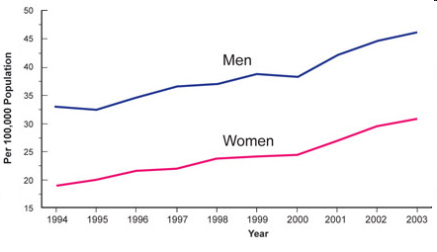
Age Adjusted Fatal Fall Injury Rates* Among Men and Women Aged 65 Years and Older, United States, 1994–2003
Reference: Centers for Disease Control and Prevention, National Center for Injury Prevention and Control. Web-based Injury Statistics Query and Reporting System (WISQARS) [online]. (2005) [cited 2006 Aug 20]. Available from URL: www.cdc.gov/ncipc/wisqars.

Slide 6
Incidence of Dizziness & Balance Problems
Accounts for 5-10% of all MD visits
  11.3 million visits/year
90 Million Americans (42% of population) will complain of dizziness to MD in their lifetime (NIH Report)
In one year 5,267,000 Americans sought medical help for dizziness
  500,000 of this group were severely disabled by their symptoms (Nat. Ambulatory Med Care Study)
Worthington, 2005

Slide 7
Incidence continued
40% of people > 40 years old have balance problems
38% of all balance problems are related to vestibular pathology; 50-60% in the elderly
Worthington, 2005

Slide 8
Falls can lead to head injury
This year over 450,000 people – mostly young (15 to 24) will suffer head injuries
79% will complain of headaches, dizziness and/or memory problems
The majority with moderate to severe injury will have persistent vertigo and imbalance for up to 5 years after the injury.
Many will be unable to return to work
Worthington, 2005

Slide 9
Falls and the Elderly
#1 Reason for someone >65 yrs old to consult a physician
40-50% of people >65 will fall yearly
  50% fall repeatedly
16% of falls require medical care
5% of falls lead to fractures at average cost of$12,000/incident
Falls are the leading cause of death due to injury in people >75
Worthington, 2005

Slide 10
Factors of a Fall
Defined – “an unexpected event in which the participant comes to rest on the ground, floor, or lower level”
  Lamb S. et al. JAGS 2005;53:1618-1622.
Intrinsic
  Physical ability – all related to Balance
    Includes vision
Extrinsic
  Environment
  Medication
Hauer, K et al. Systematic review of definitions and methods of measuring falls Age and Ageing 2006; 35:5-10.
Ganz D. et al. Monitoring falls in cohort studies of community-dwelling older people: effect of the recall interval. JAGS 2005; 53:2190-2194.
Notes:
First – Definition is an issue in research – What is a fall? Words such as: inadvertent, unplanned, sudden” Also attempts to separate falls from unavoidable falls – a fall that a healthy 20-y/o would also sustain under certain circumstances. THE latest consensus…..
Lamb S. et al. Prevention of falls network Europe and Outcomes Consensus Group. Development of a common outcome data set for fall injury prevention trials: the Prevention of Falls Network Europe consensus.
The US has adopted this definition as well. In launching the National Fall Prevention Campaign in 2005.
HAUER, Klaus, LAMB, Sarah, JORSTAD, Ellen, TODD, Chris; CLEMENS BECKER, Clemens.
Age and Ageing 2006; 35: 5–10
disagreement.
Settings: community-dwelling and institutionalized older persons.
Results: 90 publications met the predefined inclusion criteria. Of these, 44 provided no definition of the term fall. In the
remainder, there were substantial variations in the definition and methods of measuring falls. Reporting periods ranged from
1 week to 4 years with only 41% using prospective data collection methods.
Conclusion: the standard of reporting falls in published trials is poor and significantly impedes comparison between studies.
The review has been used to inform an international consensus exercise to make recommendations for a core set of outcome
measures for fall prevention trials.
Monitoring Falls in Cohort Studies of Community-Dwelling
Older People: Effect of the Recall Interval
David A. Ganz, MD, MPH,wz § Takahiro Higashi, MD, PhD,k and
Laurence Z. Rubenstein, MD, MPHwz
JAGS 53:2190–2194, 2005

Slide 11
The Truth About Falls
Not a natural consequence of aging
Often a sign of underlying disease
Appropriate intervention is dependent on diagnosis and identification of deficits
Multifactorial interventions are proving effective
Elderly have not lost capability to improve
75% of balance impaired people can improve
The sooner the intervention the better
Worthington, 2005

Slide 12
The Anatomy of Balance

Slide 13
What Keeps us Balanced?
Sensory Mechanisms
  Vestibular system
  Somatosensory system
  Vision
Central Processing / CNS
Motor Response
  Modulation
  Timing
  Power / Torque
  Range of Motion

Slide 14
When the sensory systems disagree…
Typically, when the sensory systems of balance disagree, the patient reports that they are “dizzy”
But……

Slide 15
…but exactly what IS Dizziness?
Is Dizzy Truly Dizzy?
Vertigo
Imbalance
Spinning
Rocking
Swaying
Twirling
Rolling
Like a merry go round
Unsteady
Lightheaded
“not connected”
Imbalanced
Just not sure
Disoriented

Slide 16
Vestibular System
The Inner Ear
  Cochlea: Organ of Hearing
  Vestibular system
    “motion” detectors
  Share same fluid
  Share same nerve
  Often hearing loss & vestibular problems occur together

Slide 17
Vestibular System: Detectors for all types of movements
Angular (Rotational)
  Head turns, tilts, and nods
Linear (in a straight line)
  Elevator
  Side to side
  Back and forth

Slide 18
Somatosensory
Of or relating to the perception of sensory stimuli from the skin and internal organs
A sub category is called proprioception
  …is the sense of the relative position of adjacent parts of the body

Slide 19
Vision
In order to determine orientation in space and to compare with other balance inputs, the brain process visual information related
  self movement
  environmental motion

Slide 20
What can go wrong…

Slide 21
So What Can Go Wrong?
Balance / Dizziness
Other Systems / Causes
Sensory Impairments
  Vestibular
  Somatosensory
  Vision
Central Processing Impairment
  Weighting
  Processing
Motor response deficit
  (all of the above)
Cardiovascular or Pulmonary
Medications
Hormones / Enzymes
Hydration
Migraines

Slide 22
Assessment: The very basics

Slide 23
The Detective Game
Peripheral
Integration
Central
Vestibular
Transient
Permanent
Unilateral Weakness
TIA
BPPV
CVA
Orthostatic Hypotension
Other
TBI
Often a combination of issues.

Slide 24
Case History
Symptoms
Additional Information
Onset
Duration
Frequency
Intensity
Description
Aggravate/relieve
Patterns
Medications
Diet
Hydration
Activity / exercise
Other health issues
General function

Slide 25
Observation
Walking
General Mobility
Steadiness
Use of arms
Step length / width
Speed
Conversation
Head movement
Gaze
Smoothness
Nystagmus
Coming to stand
  Need assist
  Pause
  Head position
Donning/doffing coat
Reaching – purse / hand shake
Turning corners
General appearance

Slide 26
Screen Tools - Dizziness
General Screen
Movement Induced
Vitals – BP; HR; O2
Ocularmotor
  ROM; Smooth pursuit; Saccades
Vestibular Ocular Reflex
  Slow
  Fast
  Cancellation
Cervical Active Range of Motion
Dix Hallpike
  Standard
  Sidelying
Any movements

Slide 27
Screening for vestibular problems…
Purpose is to identify and localize the site of the problem with the vestibular system
Screening has been shown to be clinically useful
Screening areas
  Ocular motor
  Vestibular Ocular Reflex (VOR)
  Vestibulo spinal reflex (VSR)

Slide 28
So what are we looking for…?
Voluntary eye movement (Ocular Motor)
  Slow/fast/combination
Involuntary eye movement: Nystagums

Slide 29
So what are we looking for…?
Voluntary Eye Movement (Ocular Motor)
  Range of motion (ROM)
  Smooth pursuit (also called tracking)
  Saccadic pursuit (fast eye movement)

Slide 30
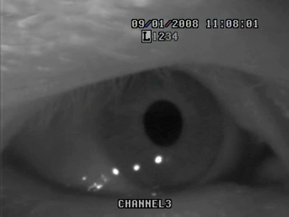
Saccadic Pursuit

Slide 31
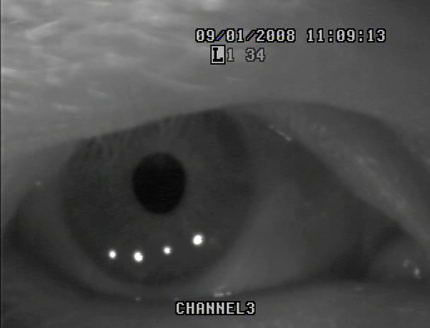
Tracking (smooth pursuit)
Slow

Slide 32
So what are we looking for…?
Involuntary eye movement: Nystagmus
    Nystagmus
      Greek word “nystanzien” which translates to “nod”
      Literally, any involuntary eye movement
        Horizontal
        Vertical
        Equal or unequal velocities and directions
      “Type” can suggest an anatomical site or physical process

Slide 33
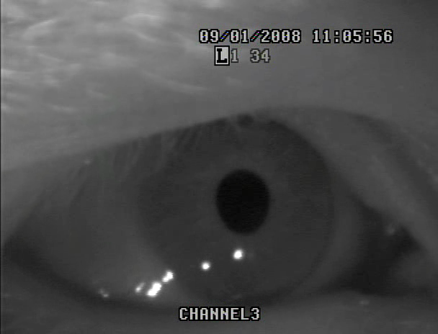
Types of Nystagmus
Left-beating

Slide 34
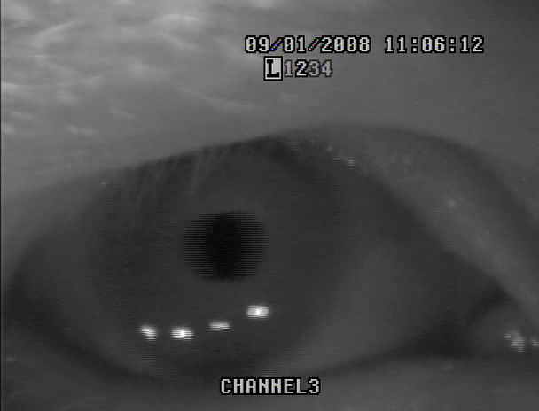
Types of Nystagmus
Right-beating

Slide 35
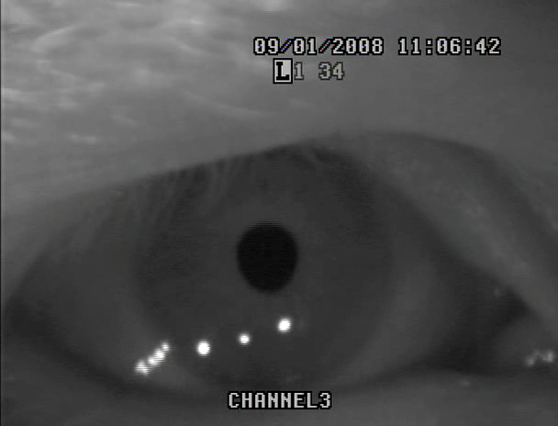
Types of Nystagmus
Up-beating

Slide 36
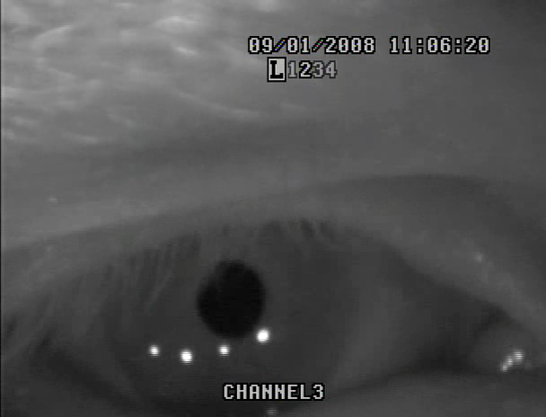
Types of Nystagmus
Down-beating

Slide 37
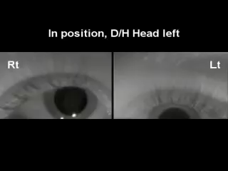
Types of Nystagmus
Twisiting / arcing (also called torsional / linear

Slide 38
Practice

Slide 39
Practice
General Screen
Movement Induced
Vitals – BP; HR; O2
Ocularmotor
  ROM; Smooth pursuit; Saccades
Vestibular Ocular Reflex
  Slow
  Fast
  Cancellation
Cervical Active Range of Motion
Dix Hallpike
  Standard
  Sidelying
Roll Test
Any movements
  Motion Sensitivity Q
  Lunges; Stops

Slide 40
Screening Tools - Balance
Static
Dynamic
Romberg
  Eyes open / closed
  Firm or Soft Surface
  Tandem
  Head and body turns
  Gaze
Nudge and Release
Single Leg Stance
Get up and Go
Dynamic Gait Index
  4 –item
  12 - item
Functional Gait assessment
Functional Tasks
  Squat or reach
  Turn – eyes open / closed
  Toes

Slide 41
Practice - Balance
Static
Dynamic
Get up and Go
Dynamic Gait Index
  4-item version
  12-item version
Functional Gait assessment
Functional Tasks
  Squat or reach
  Turn – eyes open / closed
  Toes
Rhomberg
  Eyes open / closed
  Firm or Soft Surface
  Tandem
  Head and body turns
  Gaze
Nudge and Release
Single Leg Stance

Slide 42
Results
If neurologic signs and symptoms, refer to neurologist.
  PT or OT may be indicated for balance
If true spinning, refer to ENT, audiologist, PT or OT that specializes in vestibular treatment.
If imbalanced, refer for balance rehab – can be PT or even a community program.

Slide 43
Where to Go?
Physical Therapists
Audiologists
Ear, noise, and throat (ENT) Specialist (MD)
  Neurologist
  Cardiologist
  Psychologist
  Dietician

Slide 44
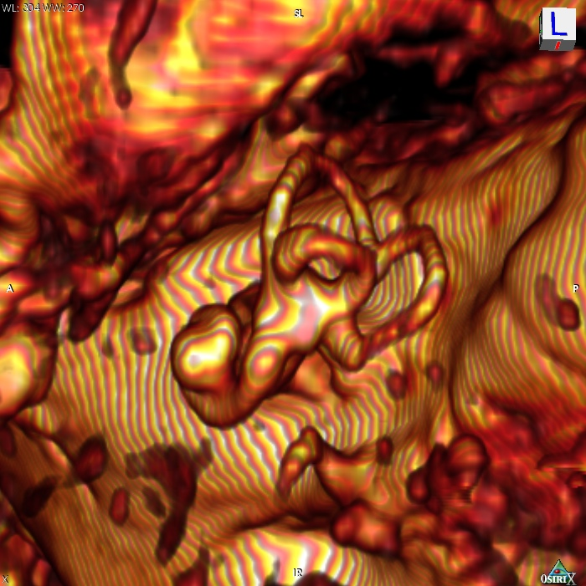
Questions??

Slide 45
References
GENERAL
  Herdman SJ. Vestibular Rehabilitation. 3rd ed. Philadelphia, PA: F.A.Davis Co; 2007.
  Shumway-Cook A, Woollacott M. Motor Control: Theory and Practical Applications, Lippincott, Williams and Wilkins Baltimore, Md, 1995:323-324
  Schubert MC, Minor LB. Uestibulo-ocular physiology underlying vestibular hypofunction. Physical Therapy, 2004;84(4)373-386.
  http://www.cdc.gov/print.do?url=http%3A//www.cdc.gov/ncipc/factsheets/adultfalls.htm
  Reference: Centers for Disease Control and Prevention, National Center for Injury Prevention and Control. Web-based Injury Statistics Query and Reporting System (WISQARS) [online]. (2005) [cited 2006 Aug 20]. Available from URL: www.cdc.gov/ncipc/wisqars. Neil Bhattacharyya N, Baugh RF Orvidas L, et al., Clinical practice guideline: Benign paroxysmal positional vertigo. Otolaryngology–Head and Neck Surgery, 2008;139:S47-S81
  Hillier SL, Hollohan V. Vestibular rehabilitation for unilateral peripheral vestibular dysfunction (Review). The Cochrane Collaboration. 2007.
  Lyons SS. Fall Prevention for older adults. Iowa City: University of Iowa Gerontological Nursing Interventions Research Center, Research Dissemination Core; February 2004. National Guideline Clearinghouse – AHRQ.

Slide 46
References
TESTS
  Wrisley, DM, Marchetti GF, Kuharsky DK, Whitney SL. Reliability, internal consistency, and validity of data obtained with the functional gait assessment. Physical Therapy, 2004;84(10):916-918.
  Walker ML, Austin AG, Banke GM et al. Reference group data for the functional gait assessment. Physical Therapy. 2007; 87(11):1468-1477.
  Fritz S, Lusardi M. White paper: walking speed: the sixth vital sign. Journal of Geriatric Physical Therapy, 2009; 32(2):2-5.
  Marchetti GF, Whitney SL. Construction and validation of the 4-item dynamic gait index. Physical Therapy, 2006;86(12)1651-1660.
  Duncan P, Weiner D, Chandler J, et al. Functional reach: a new clinical measure of balance. J of Gerontol, 1990;45:M192-197.
  Humphriss RL, Baguley DM, Sparkes V, Peerman SE, Moffat DA. Contraindications to the Dix-Hallpike Manoeuvre: a multidisciplinary review. International Journal of Audiology, 2003;42:166-173.

