Slide 1
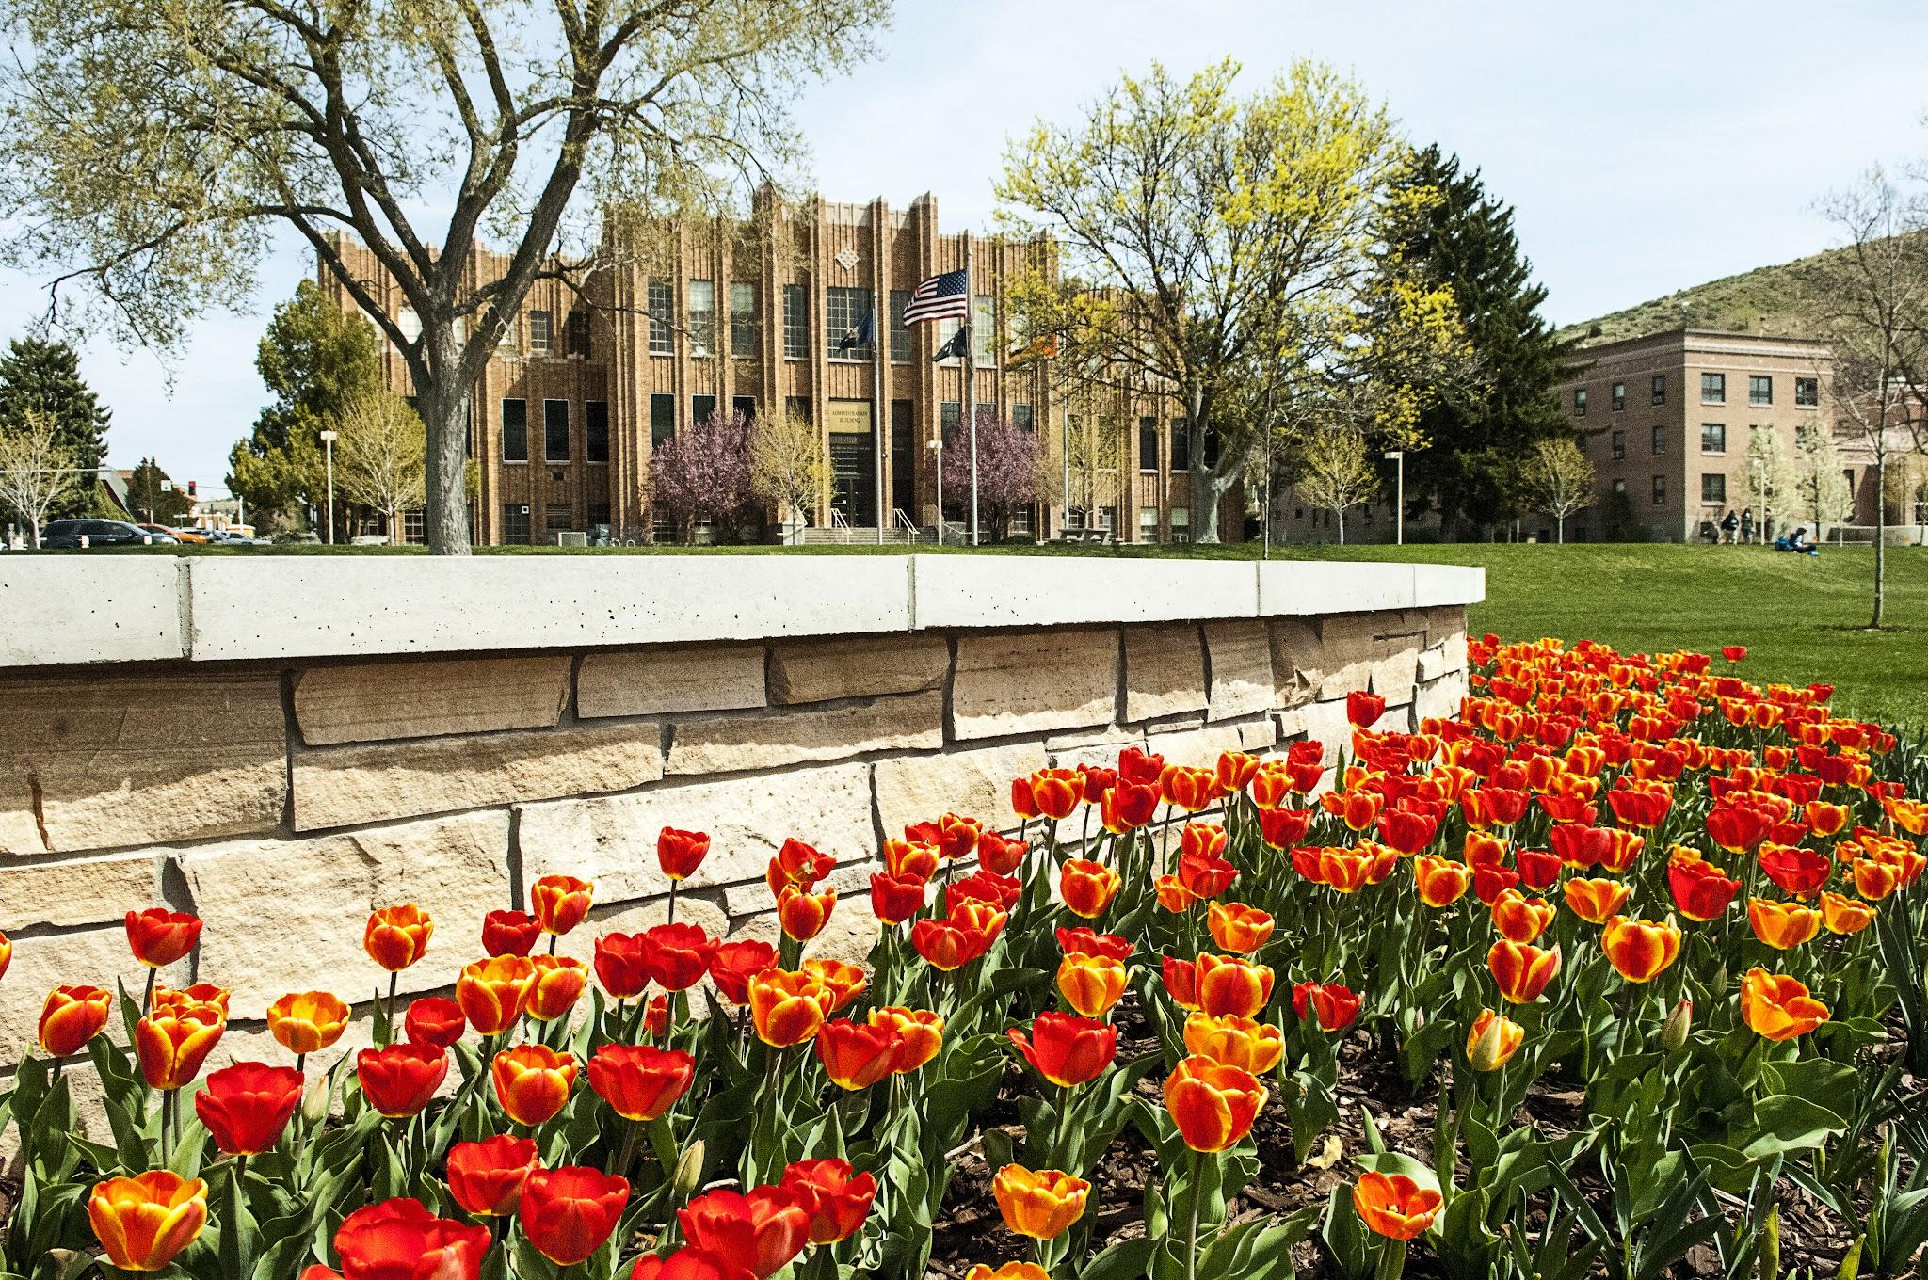
SBOE Interim Guidance Implementation
DEI Related Courses/Programs
Office of Academic Affairs
Fall 2025

Slide 2
SBOE Statements on Academic Freedom and Responsibility
“Postsecondary students enter into a voluntary higher educational experience. Students have the right, and corresponding responsibility, to engage in their learning and select the courses and programs most suitable for their own personal learning objectives. No student may be compelled or required to enroll in an academic program. Faculty may not refuse to enroll or teach a student because of the student’s beliefs, interpretations, or applications of knowledge.” See SBOE Policy III.B.
“Idaho Code § 67-5909D does not ban the use of specific words in the classroom, even those listed in the definition of ‘DEI.’ The law also provides that it shall not be construed to limit classroom discussion or academic freedom. Faculty and students are encouraged to engage in respectful dialogue about educationally-appropriate subjects in all courses, whether ‘DEI-related’ or not.”
Fall 2025

Slide 3
SBOE Statements on Academic Freedom and Responsibility (Con’t)
As it relates to academic programs, Idaho Code § 67-5909D(7) states that it “shall not be construed to”:
“Limit research by students, faculty, or other research personnel of an institution of higher education or the dissemination of such research;”
“Limit creative works by students, faculty, or other personnel of an institution of higher education or the dissemination of such creative works;”
“Limit activities of student organizations registered with an institution of higher education as long as the organization and activity do not use state funds;”
“Limit the appearance of guest speakers and performers who do not receive any form of compensation in exchange for their presentations, performances, or appearances as long as attendance is voluntary;”
“Limit the academic freedom of any individual faculty member of an institution of higher education to direct the instruction within such faculty member’s own course not otherwise subject to this section or to limit the free discussion of ideas in a classroom setting.”
Fall 2025

Slide 4
What is “Limited” by 67-5909?
"Diversity, equity, and inclusion’…trainings, programs, activities, or instruction that is derived from or that promotes the tenets or concepts of critical theory, including but not limited to[:]
● unconscious or implicit bias,
● microaggressions,
● internalized racism,
● cultural appropriation,
● structural equity,
● settler colonialism,
● group marginalization,
● systemic oppression,
● social justice,
● institutional or systemic racism,
● white fragility,
● racial privilege,
● disparate impact,
● intersectionality,
● sexual privilege,
● patriarchy,
● gender theory,
● queer theory,
● neopronouns,
● transgender ideology,
● misgendering,
● othering,
● deadnaming,
● heteronormativity,
● allyship, or
● any other related formulation of these tenets or concepts.”
The foregoing terms are subsequently referred to as the “specifically listed concepts.” Idaho Code § 67-5909D(1)(b)(i).
*“Program” refers to a combination of for-credit courses organized for the achievement of specific learning outcomes, as defined by the Institution, that culminates in a minor/major/degree/certificate, based on receipt of a certain number of academic course credits.
Fall 2025

Slide 5
What is “Critical Theory?”
SBOE Guidance: “’Critical theory’ is not defined in Idaho Code § 67-5909D. For purposes of this memorandum, it is understood to be a Western European philosophy initiated with the work of the Frankfurt School and the specifically listed concepts in the legislative definition of DEI.”
Additional Background and Information: A brief primer on Critical Theory, its fundamental goals and major figures, can be found here. You can use this resource as you consider the degree to which a course might be reliant upon the Critical Theory developed by the major thinkers associated with the Frankfurt School.
“‘Critical theory’ refers to a family of theories that aim at a critique and transformation of society by integrating normative perspectives [i.e., perspectives aimed at establishing norms and values that best fit the needs of society] with empirically informed analysis of society’s conflicts, contradictions, and tendencies.” The Stanford Encyclopedia of Philosophy
Fall 2025

Slide 6
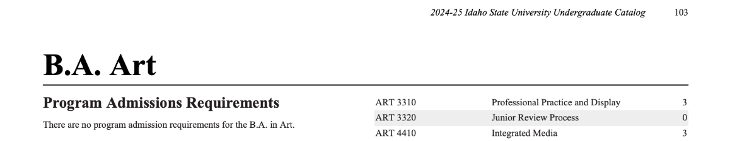
When is the law NOT Triggered?
The course is not offered for credit (non-credit course, “0” credit course).
Idaho Code § 67-5909D defines “DEI-related courses” as only those courses “taken for credit” at the institution.
Fall 2025

Slide 7
When is the law NOT Triggered? (Con’t)
The course does not meet the threshold to qualify as “derived from” or “promot[ing] tenets or concepts of critical theory” if:
Less than 90% of the course material is focused on the Specifically Listed Concepts or works of Critical Theory (see the list of theorists associated with the Frankfurt School here): “A course is “derived from” critical theory or the specifically listed concepts when, considering the course as a whole as designed by the faculty/instructor, the primary subject matter is drawn from, depends upon, or is fundamentally shaped by critical theory or the specifically listed concepts (e.g., 90% of the course material is focused on critical theory or the specifically listed concepts).” If 90% of the course is not focused on the specifically listed concepts or the works of Critical Theory associated with the Frankfurt School theorists, it does not meet the threshold to trigger the law according to the guidance we have received.
Fall 2025

Slide 8
When is the law NOT Triggered? (Con’t)
The course does not meet the threshold to qualify as “derived from” or “promot[ing] tenets or concepts of critical theory” if the course does not:
Adopt/Advocate for Specifically Listed Concepts or Critical Theory as: “normative truths, rather than merely analyzing or discussing them in an academic or critical context.” (This is what constitutes a methodology “derived from” theory or concepts of legislative concern).
Promote, i.e., actively encourage students to personally affirm, adopt or adhere to the identified concepts. Requiring students to “affirm, adopt or adhere” to the identified concepts would also violate existing Board Policy III.B. (“students may not be directed or otherwise compelled to personally affirm, adopt, or adhere to any particular political, religious, or philosophical tenet or ideology”) and Idaho Code § 33-138. Applying the guidance provided by the Attorney General in the context of the No Public Funds for Abortion Act, Chapter 87, Title 18, Idaho Code, “The plain meaning of these terms [promote] do not prohibit professors from speaking on [specified topics] in their teaching and scholarship even if that teaching or scholarship could be viewed as supporting [the topic].” AG Opinion 23-4, page 7.”
Fall 2025

Slide 9
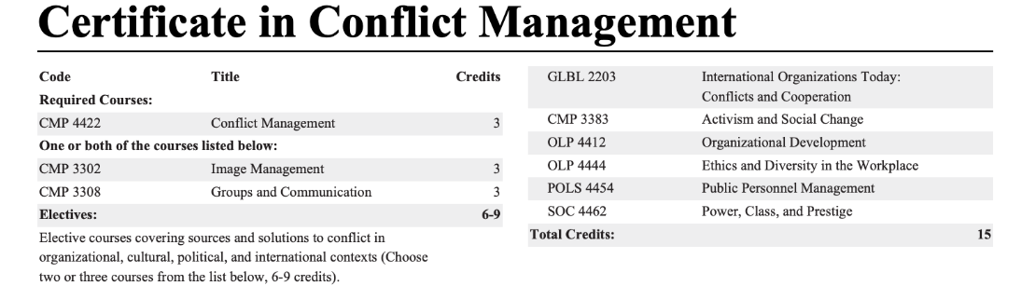
When is the law NOT Triggered? (Con’t)
When the course is required to earn the degree/certificate/credential but there is an alternative course that doesn’t trigger the law that could be taken at some point to fill the requirement.
“‘Compelled’ or ‘required’ are not defined by Idaho Code § 67-5909D. A course is either compelled or required when necessary to complete a Program. If two or more courses meet a Program requirement, and at least one of the courses is not a ‘DEI-related course,’ then the DEI-related course is not considered to be ‘compelled’ or ‘required’ to complete that Program.” These are commonly called “restricted electives.”
Fall 2025

Slide 10
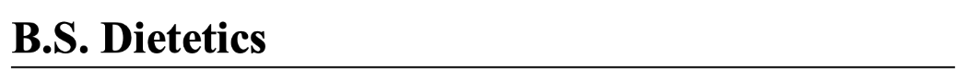
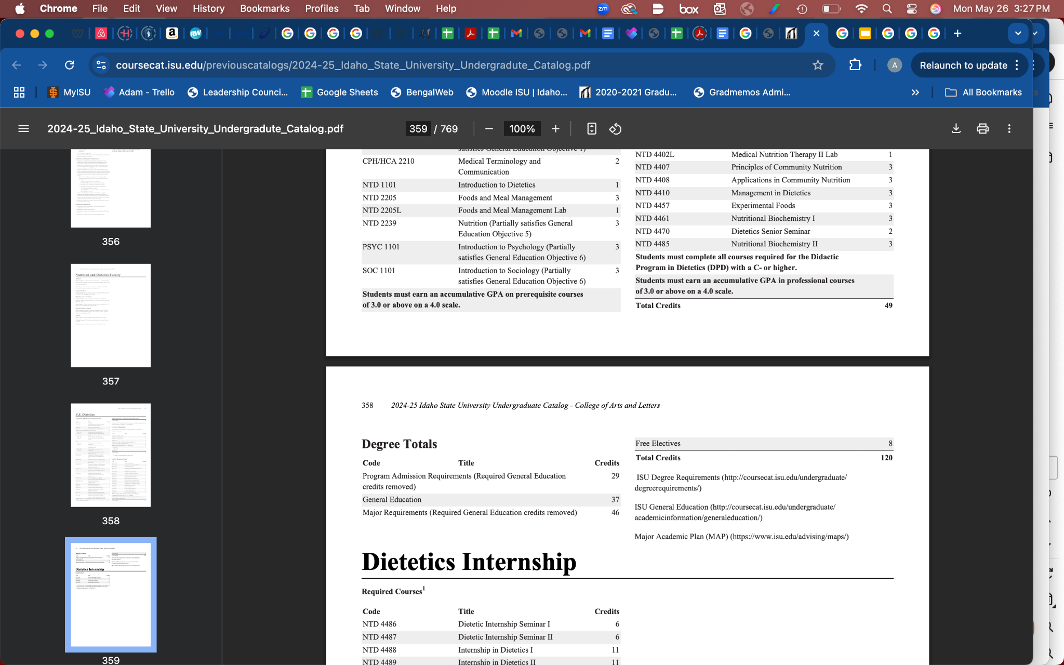
When is the law NOT Triggered? (Con’t)
When a student selects a “free elective.” The bill does not apply to elective offerings that students may independently select. “Idaho Code § 67-5909D prohibits institutions from requiring or otherwise compelling students to take ‘DEI-related courses.’”
A “free elective” is essentially when a student is allowed to take any course they wish to fulfill the total credit hours required. This is different than a “restricted elective” which is when a student is required to take a course(s) from among a contstrained list of choices (see 3 for more info).
Fall 2025

Slide 11
When is the law NOT Triggered? (Con’t)
When a programmatic exemption has been approved.
“The institution may seek an exemption for the academic degree program requirements from the Board,” when a course is 1) taken for credit, 2) meets the “90% rule” or “derived from” criteria (slides 7 and 8), and 3) must be taken (no alternatives allowed) for a student to complete their major (UG or GR).
NOTE: All three conditions must be met before we will seek an exemption. It is imperative that we be judicious in requesting program exemptions – striving to exempt what is needed, no more or less.
Fall 2025

Slide 12
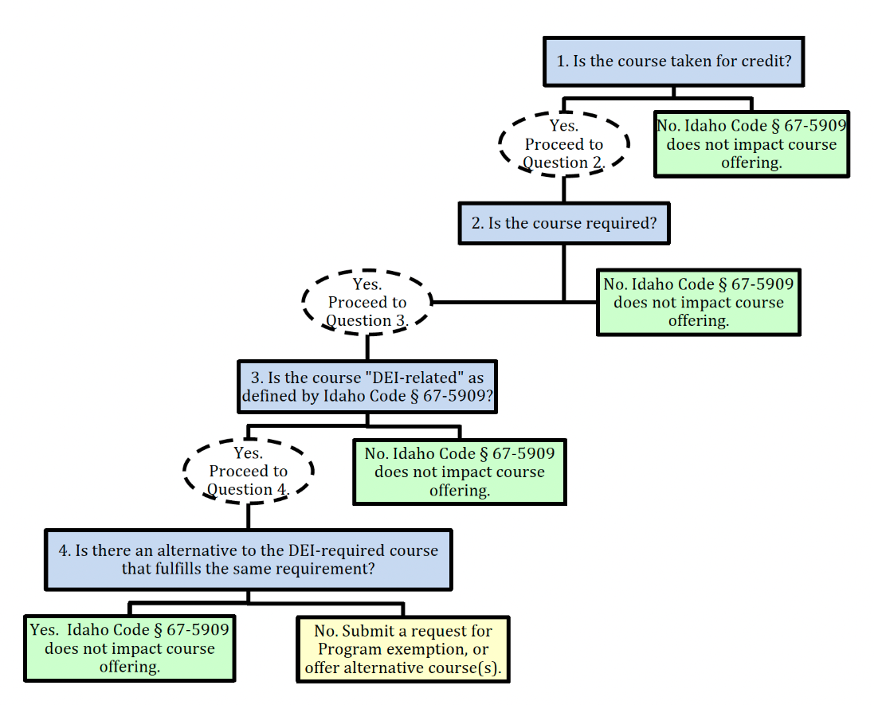
Flowchart for Decision Making

