Slide 1

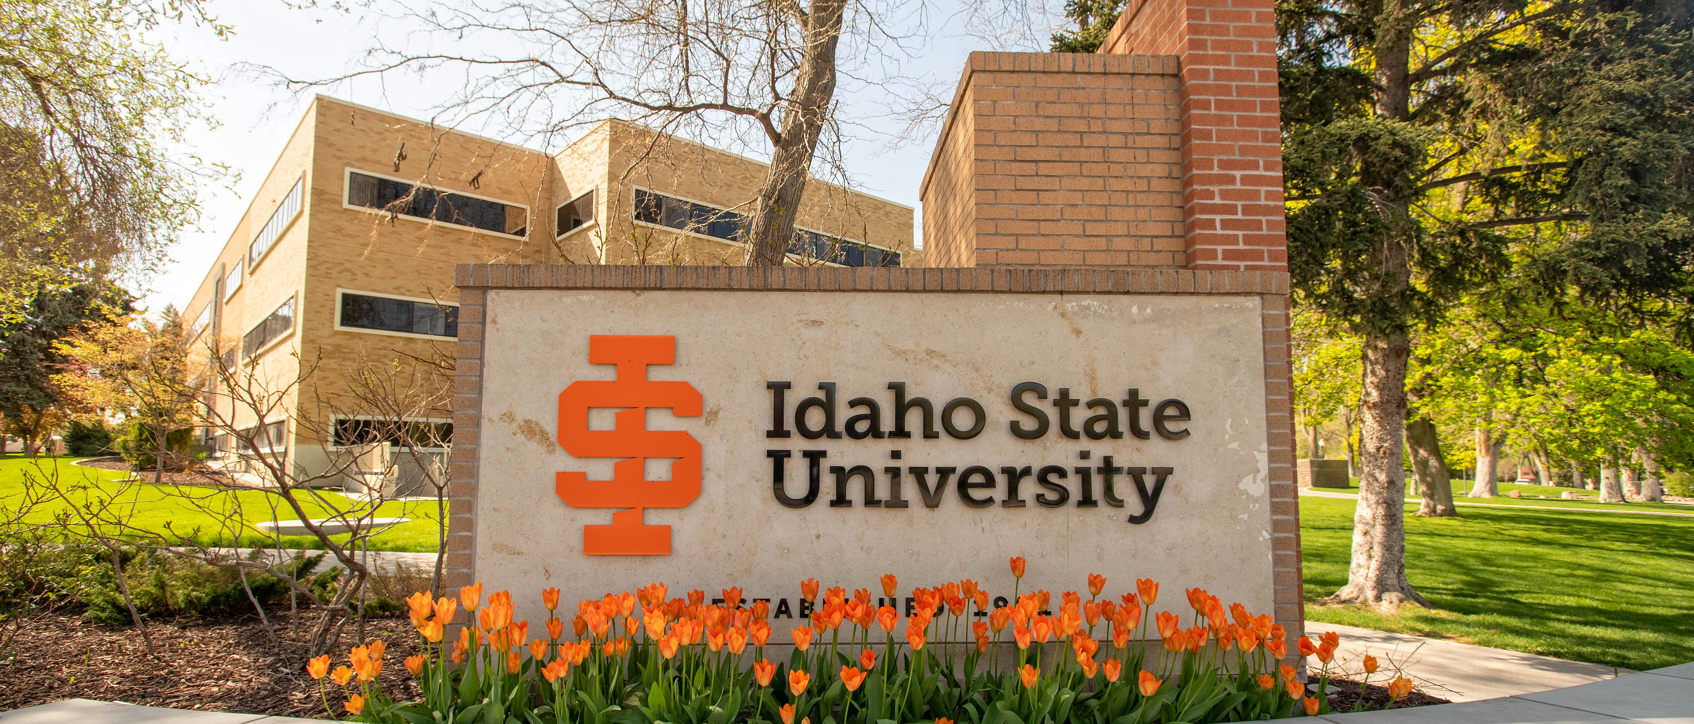

All Chairs, Program Directors & Associate Deans Meeting
August 21, 2025

Slide 2


Slide 3
Agenda Overview
Welcome & Provost Office Updates
Welcome and Overview for the Meeting - Adam Bradford
Future of Chair/Associate Dean Meetings - Cindy Hill
3-5 Year Departmental Strategic Visions - Adam Bradford
Institutional Syllabus Statements - Adam Bradford
Course & Faculty Support
Additional Proctoring Services - Doug McGee
Special Course Fee Process Update - Cindy Hill
Faculty Evaluations Update - Laura Ahola-Young
New Faculty Mentoring - Laura Ahola-Young
Center for Learning & Instructional Excellence Workshops - Doug McGee
Budget
Faculty Salary Mean Comparisons - Adam Bradford
Budget Town Hall Coming Soon
Closing
Questions/Discussion - Adam Bradford

Slide 4
Department Chair, Program Director & Associate Dean Meetings
We have a new structure for academic leadership this year.
We are inviting all Department Chairs, Program Directors and Associate Deans to join us at our new Academic Council meetings.
We will be meeting at 2:00pm in the Center for Learning & Instructional Excellence (REND 129) and on Zoom on September 25th, October 30th, and November 13th.
We look forward to seeing you!

Slide 5
3-5 Year Departmental
Strategic Visions
We read your vision statements!
We met with each dean to discuss these statements and to strategize on moving forward with a college vision.
Each dean shared this college vision at our August Deans Retreat.

Slide 6
Institutional Syllabus Statements
Idaho Code 67-5909D
Idaho Code 67-5909D was passed by the State of Idaho Legislature during the 2025 legislative session. This law places certain requirements and restrictions on state sponsored institutions of higher education as it relates to activities, instruction, and support services that may intersect with what the law refers to as “diversity, equity, and inclusion.” The university has worked to meet its legal requirements under this law, including seeking lawful exemptions for academic programming that would otherwise be subject to the restrictions created under 67-5909D. If you have any concerns about the content of this course and its relationship to the concepts identified by this law, you are responsible for meeting with the Office of Academic Advising (askanadvisor@isu.edu) to raise those concerns prior to the close of the add/drop period and discuss the possibility of other appropriate enrollment options. By maintaining your enrollment in this class beyond the add/drop period you are acknowledging your choice to engage in the full educational experience outlined in the syllabus, which may include assignments, discussion, readings, grading, etc., related to concepts identified under this law.

Slide 7
Institutional Syllabus Statements
Academic Freedom and Responsibility
In carrying out its educational mission, Idaho State University is committed to adhering to the values articulated in Idaho State Board of Education Policy III.B. Membership in the academic community imposes on administrators, faculty members, other institutional employees, and students an obligation to respect the dignity of others, to acknowledge the right of others to express differing opinions, and to foster and defend intellectual honesty, freedom of inquiry and instruction, and free expression on and off the campus of an institution.

Slide 8
Institutional Syllabus Statements
Academic Integrity
It is important that students submit their own, original (never previously used) work throughout the class. Submitting previously used work and/or work that is not your own original work is considered a violation in academic integrity. Academic Integrity is something that all students should know about and take measures to uphold – it ensures the value of your degree. The credibility of the university as a whole is diminished if academic integrity is not upheld.
Types of Violations
There are four types of academic dishonesty: (1) Plagiarism; (2) Fabrication; (3) Cheating; and (4) Aiding and Abetting Dishonesty.
Rarely does anyone set out to violate standards of academic integrity; plagiarism and cheating usually occur because students are in a hurry and take some short cuts to submit the required assignment. The best remedies to ensure academic integrity are thus to keep up with the class and to ask questions along the way. It is important that you know that intentionality (“I didn’t know” or “I didn’t mean it”) Is not a valid excuse for violating standards of academic integrity. Penalties for violating Academic Integrity may include receiving an "F" on the assignment, an "F" in the course, and notification of the Registrar. Multiple instances of Academic Dishonesty at ISU may result in suspension or expulsion. You should thus talk with your instructor before submitting your work if you have any questions about your use of sources or other information.

Slide 9
Institutional Syllabus Statements
ISU Book Bundle
(isu.edu/bookbundle)
Upon registering for classes each semester, all Idaho State University students are automatically enrolled in the ISU Book Bundle, the university's official textbook and course material delivery program. The ISU Book Bundle ensures students have their required course materials on or before the first day of class. Through the ISU Book Bundle, physical books are conveniently packaged and provided to students on a rental basis. Digital materials are delivered directly through Moodle (beginning Fall 2025, Canvas). All students have the opportunity to opt out of the program each semester. Costs for all required course materials will be added to your tuition and fees.
To opt out: follow the website link above. The dates to select your Fall course material pick-up location or opt out are August 8 - September 12. There will be no refunds after the end of the opt-out period.
Reasonable Accommodations:
ISU is committed to providing an accessible learning environment for students with documented disabilities. If there are aspects of the instruction or design of this course that result in disability- related barriers to your participation, please contact Disability Services to engage in a confidential conversation about the process for requesting accommodations.
Students are encouraged to register with Disability Services as soon as they begin this course, or in the timeliest manner possible, as accommodations are not provided retroactively. More information can be found on the Disability Services website.
· Hours: 8:00 – 5:00, Monday - Friday
· Phone: (208) 282-3599
· Fax: (208) 282-4617
· Email: disabilityservices@isu.edu
Location: Rendezvous Complex, Room 125 (Pocatello Campus) ISU also offers Services in Idaho Falls, Meridian, and Twin Falls

Slide 10

Additional Proctoring Services
Honorlock is widely recognized as a leader in online proctoring, with strong adoption and high satisfaction at several regional institutions and will be available in Canvas this fall.
Benefits of Honorlock include:
Better Technology & Service: Honorlock offers human-proctored exams for all students, with no setup or training fees. It integrates directly with Canvas and works for exams outside the LMS.
Student-Friendly: Unlike ProctorU, Honorlock eliminates extra costs such as $15 late check-in or rescheduling fees.
Cost-Effective: A fixed-cost, unlimited model supports broader use across courses while avoiding the unpredictable fees of ProctorFree and ProctorU.
To minimize disruption, both ProctorU and ProctorFree will remain available throughout the entirety of the Fall 2025 semester.
We will transition fully to the new proctoring software, Honorlock, beginning with the Spring 2026 semester.

Slide 11

Special Course Fee Process Update

Slide 12

Faculty Evaluations Update

Slide 13
New Faculty Mentoring
We hope and expect that new faculty at ISU will find a rich array of resources and people in their departments available to help them during their first year. The New Faculty Cohort Mentoring Program organized by Academic Affairs is not meant to be a substitute for mentoring relationships that develop naturally within, or even outside of, a faculty member’s department.
The purpose of the New Faculty Cohort Mentoring Program is twofold:
To help new faculty make their transition to the wider life of the ISU community
To provide seasoned ears and voices for new faculty as they address the challenges and experience the rewards of teaching at ISU.
The goals of the new faculty mentoring program are:
Reinforcing community building through a cohort model
Providing a holistic model of mentoring that helps new faculty members identify support networks
Identifying institutional resources for support

Slide 14
Center for Learning & Instructional Excellence
The Center for Learning and Instructional Excellence provides a flexible space designed to support events that foster collaboration, innovation, and professional growth. In addition to attending various functions, such as those listed below, faculty, staff, and campus partners are invited to reserve the Center for a variety of purposes as well.
Learning Communities
Master Teaching Workshops
“One Thing” Workshops
Book Launches
Faculty Development Workshops (New Faculty Mentoring)
Sabbatical Presentations
Visiting Scholars/Guest Speakers
Assessment Support
Department Retreats
Council Meetings
Reservations for the Center can be made here

Slide 15
Faculty Salary Mean Comparisons
Objective
Develop a phased approach to identify, analyze, and rectify faculty compensation deficiencies relative to market comparisons.
Part 1– Faculty Promotion Adjustments
Part 2-- Market adjustments
* Budget Town Hall in near future

Slide 16

Questions/Discussion

